Slide 1
Sealingtech Lunch and Learn: Pt.1 – Docker
Markus Mabson
Daniel Lohin

Slide 2
Agenda:
Day 1
Introduction to Docker and Kubernetes
Docker Overview
Docker lab
Day 2
Kubernetes Overview
Kubernetes Lab

Slide 3
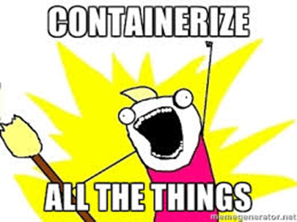
Introduction to Docker and Kubernetes
Rapid Deployment, Isolated Environment, Developer productivity.

Slide 4
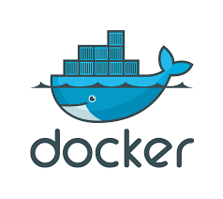
What is Docker?
Docker, is an open-source project that automates the deployments of applications inside of user created containers by providing an added layer of abstraction and automation that has the capability to perform operating system level virtualization.

Slide 5
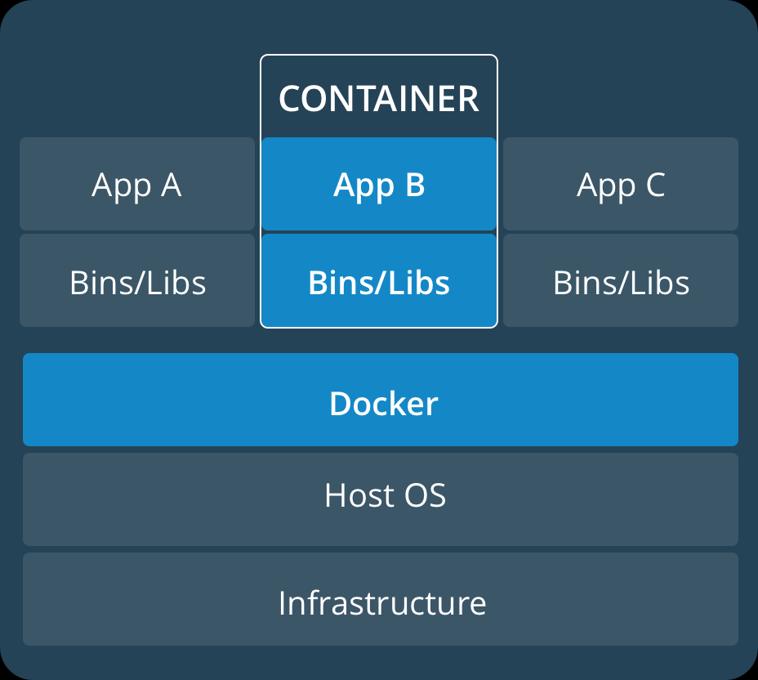
A Container?
Lightweight, stand-alone software that includes system tools, system libraries executable package.
Packaged software for development, shipment as well as deployment
Containers share the machine’s OS kernel
Containers are isolated using namespaces
PID
Networking
Mount Points
UID/GID
Limit processors and memory
And more!

Slide 6
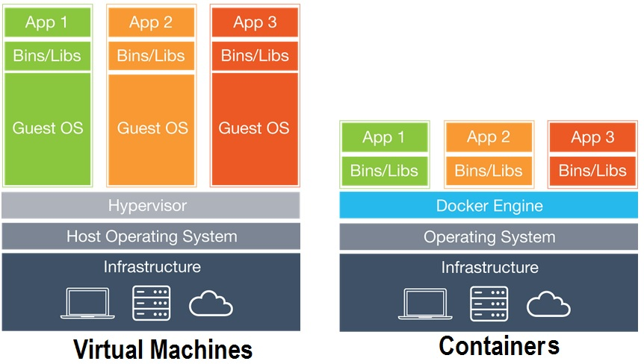
What’s the Difference?

Slide 7
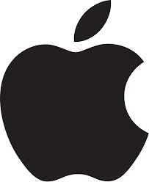



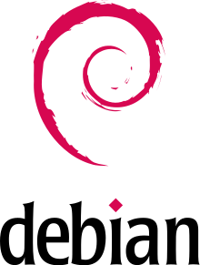

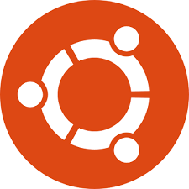
Supported Platforms

Slide 8
Kubernetes
A method of orchestrating containers across cloud type environments
Developed by Google based on how they internally managed their infrastructure
Focuses on building highly scalable systems using commodity hardware
Orchestrates the networking, storage and compute using ”infrastructure as code” design

Slide 9
What is Kubernetes
Kubernetes acts as an abstraction to the infrastructure so that applications don’t need to understand the details of what it looks like
Kubernetes is highly extensible with plugins and every cluster will look different, but generally that is ok because Kubernetes solves the details for you. As long the the plugins and clusters follow a certain set of rules, the underlying details not longer matter.
Kubernetes is designed to deploy and manage the lifecycle of containers across a number of hosts

Slide 10
Dockerfile
A Dockerfile, is a text document that holds all the commands that a user could call on the command line to create an image.
A lot of dockerfiles already exist for your common applications on Docker Hub!

Slide 11
What does this solve?
Configuration management – Think of how many times in your IT career you decided that it was best to start over with a server?
Upgrade path craziness and testing – oh you went from 1.11 to 1.13, we didn’t test that why didn’t you install 1.12
Documentation hell – mounds of documentation that can be unclear, as well as operator error
Makes development, testing and production a highly repeatable operation – how many times did you find a bug in production because they were using some other piece of hardware or software that wasn’t in testing.

Slide 12
Some core concepts of Devops
Docker and Kubernetes exist as technologies to enable Devops. Here are some key concepts:
Containers are cattle, not pets. Use them, shoot them and then move on
Fail fast – we will fail, but it is important that when we fail we can quickly revert back to a known state.
Continuous Integration - Deploy small changes more frequently
Shared environments – Dev, test, production should all be identical if not the same
Deployment should be as hands off as possible.

Slide 13
Docker Overview

Slide 14
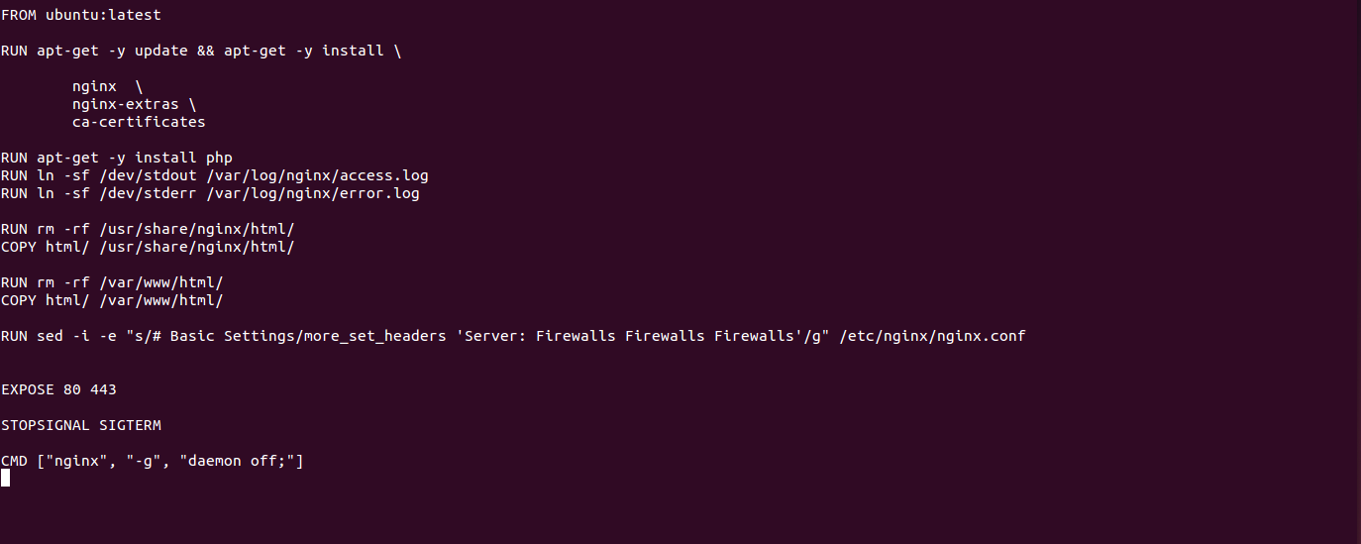
Nginx – Dockerifle

Slide 15
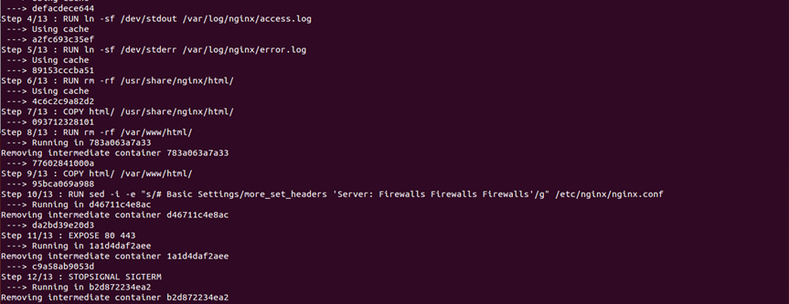
Container Creation
$ Docker Build –t nginx .

Slide 16
Hands on -Demo

Slide 17
Resources
Github - https://github.com/docker
Docker Hub – https://hub.docker.com/
Docker - https://www.docker.com/

Slide 18
Try it yourself!
*Link to completed Docker Guide –[Sharepoint]*

